Slide 1

Bank Loan Case Study
Bank Loan Case Study
Final Project 2 Project By: Sumit Gope

Slide 2
Project Description:
The aim of this project is to apply exploratory data analysis (EDA) techniques to understand the patterns present in loan application data and identify the driving factors behind loan default. The dataset used in this project contains information about loan applications at the time of applying for the loan, as well as previous loan data for clients.
The problem statement for this project is to identify patterns that indicate if a client has difficulty paying their installments, which can be used to take actions such as denying the loan, reducing the amount of loan, or lending to risky applicants at a higher interest rate. The company wants to understand the driving factors behind loan default, i.e. the variables that are strong indicators of default, which can be used for portfolio and risk assessment.

Slide 3
Approach
The analysis approach for this project involves the following steps:
1.Data Understanding: This involves understanding the structure and contents of the dataset and data dictionary provided, and identifying any missing data and outliers.
2.Data Cleaning: This involves dealing with missing data and outliers using appropriate methods, such as removing columns or replacing missing data with an appropriate value.
3.Univariate Analysis: This involves analyzing individual variables in the dataset and identifying any trends or patterns.
4.Bivariate Analysis: This involves analyzing the relationship between two variables in the dataset and identifying any trends or patterns.
5.Top Correlation Analysis: This involves finding the top 10 correlations for the client with payment difficulties and all other cases, segmented by the target variable, to identify the driving factors behind loan default.

Slide 4



Tech-Stack Used
Excel 2010 and Microsoft 365 web
Power BI
PowerPoint

Slide 5
Overall Approach of analysis:
The bank’s problem statement is to identify the major cause of bank loan default. So below are the data sets provided to analysis.
1.application_data.csv contains all of the client’s information at the
time of application. The information related to whether or not a client is
having financial issues.
2.previous_application.csv provides data from the client’s previous
loans. It indicates if the prior application was Accepted , cancelled
Refused or Unused.
Both sets of data contained many undesired columns that will not be used for risk analytics as well as many blanks. So I cleaned up the data.
Data sets contains Categorical variables as well as Numerical variables.

Slide 6
Insights (Application_data.csv)
Data Cleaning
The dataset contained 3 lac+ rows and 161 columns of data.
I deleted numbers of columns containing more than 45% of blank data.
For this I used =countblank() function.
After got total blank rows of each column I divided total number of column and multiply by 100 so we got percentage of blank column.
After deleting unwanted columns we got 72 remaining columns.

Slide 7
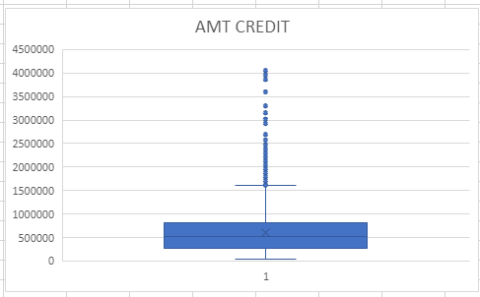
Outliers
Outliers can only be identified on Numerical variable.
To find outlier basically I used Box and Whisker chart.
Q1 | 270000
Q3 | 808650
IQR (Q3-Q1) | 538650
UPPER BOUND [Q3+(1.5*IQR)] | 1616625
LOWER BOUND [Q1-(1.5*IQR)] | -942975
Statistical formula on excel that, why it is outlier.

Slide 8
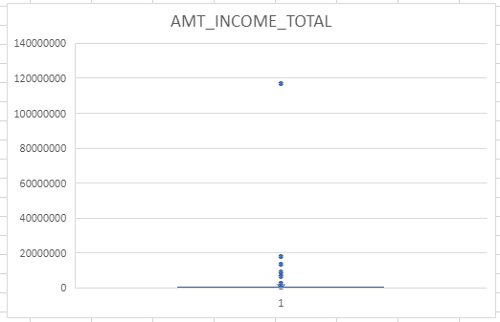
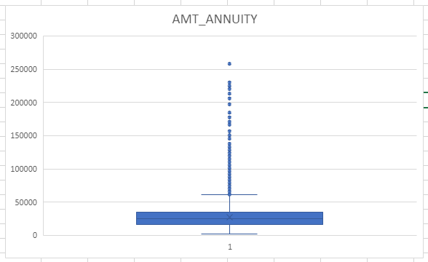
Q1 | 112500
Q3 | 202500
IQR (Q3-Q1) | 90000
UPPER BOUND [Q3+(1.5*IQR)] | 337500
LOWER BOUND [Q1+(1.5*IQR)] | -22500

Slide 9
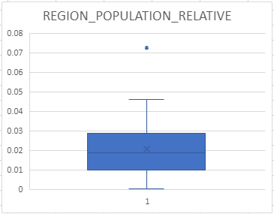
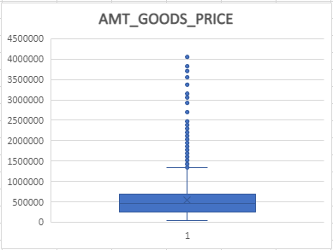

Slide 10
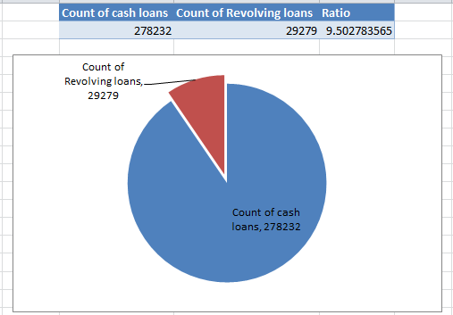
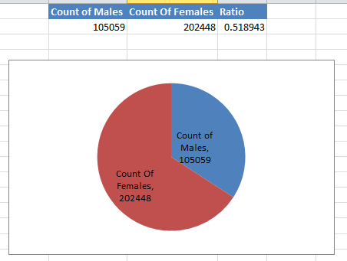
Data Imbalance and Ratio
Data Imbalance occurs when data is disseminated is an unequal manner. I plotted data imbalance using pivot table.

Slide 11
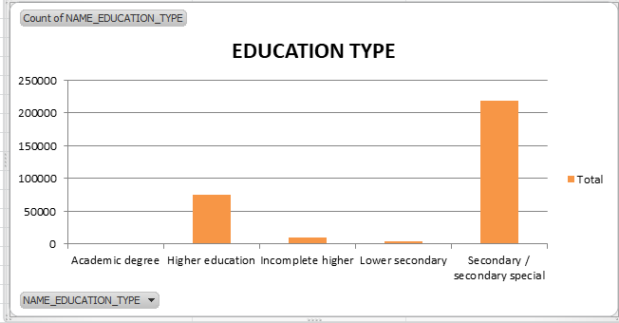
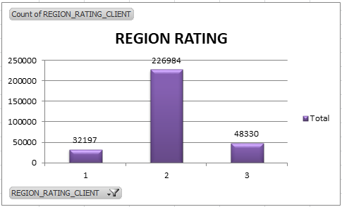

Slide 12
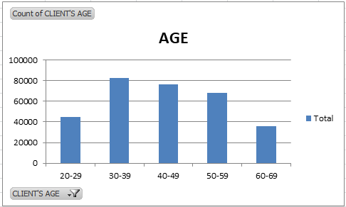

Slide 13
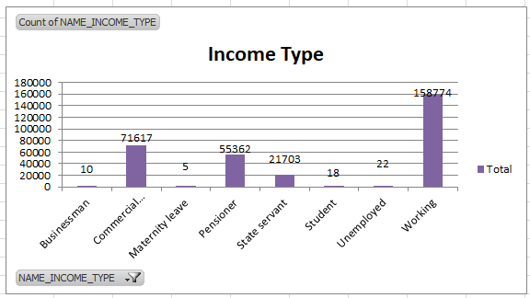
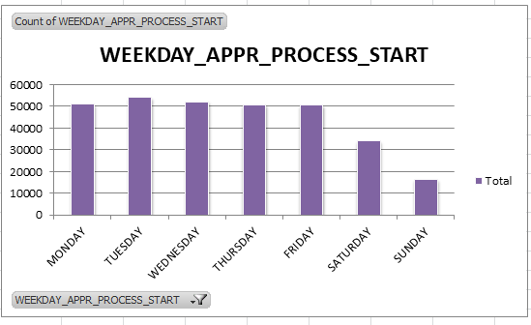

Slide 14
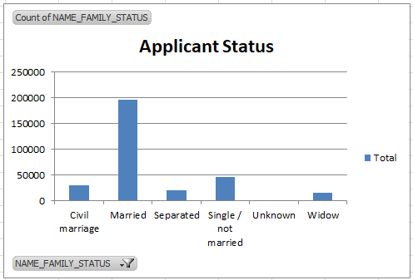
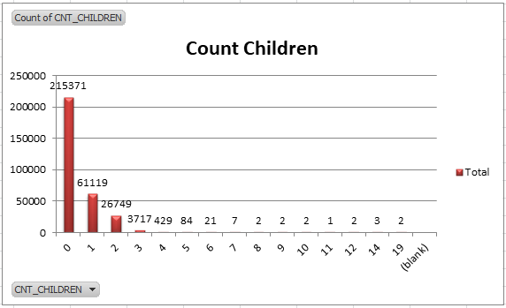

Slide 15
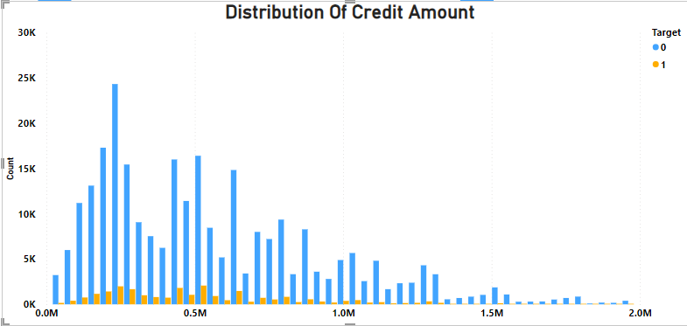
Univariate Analysis:
So for univariate analysis I used power BI tool I drag the credit amount into x-axis and drag target variable into y-axis as well as into legend.
Clients with credit range lying between 0.2M-0.6M are capable of paying loan bank.
Least number of clients lying in income range 1.3M-above are not capable of paying.

Slide 16
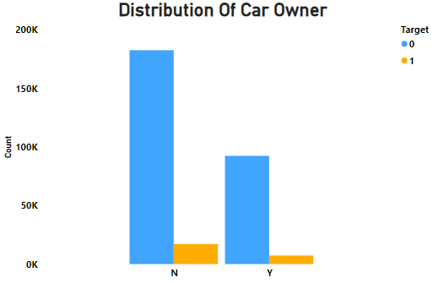
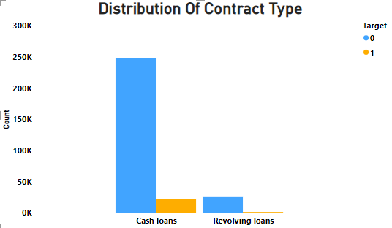
Its shows that clients without having car ownership have no payment difficulties than clients having car.
1.Most cash loans applicants have payment difficulties.
2.The same type of loans also have the most applicants with payment difficulties.

Slide 17
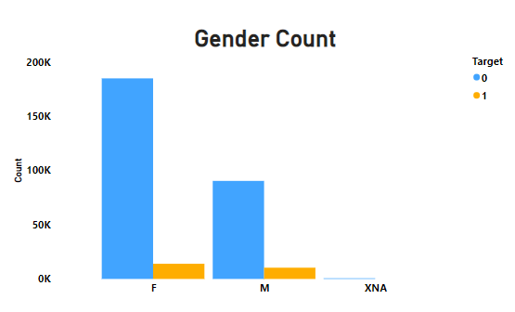
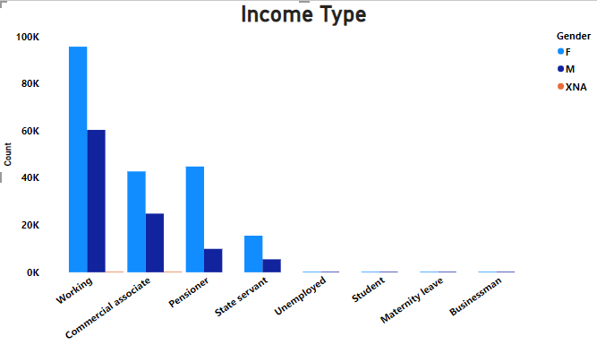
It can be seen that both number of males and females are same for having payment difficulties
2. It can also be seen that
number of females is
more than males for not
having payment
difficulties.
1. We can conclude that most clients who fall in working type income category are applying for loans.

Slide 18
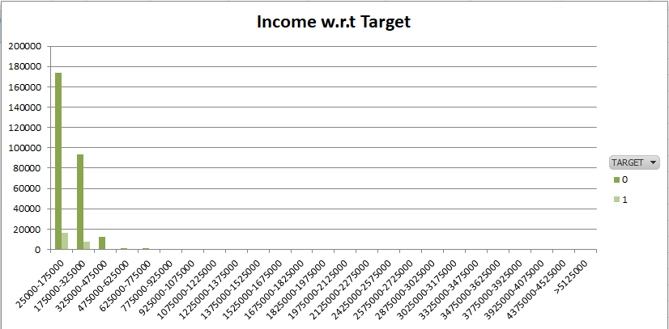
From the above plot we can infer that the maximum number of clients without payment difficulties lie in the income range 25K-475k.
but maximum number of client with payment difficulties lie in range 25k-175k.

Slide 19
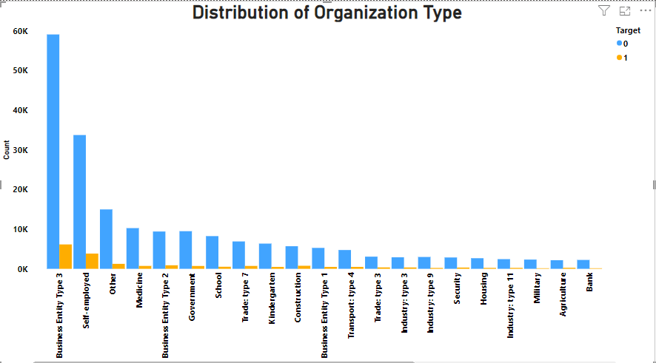
Most clients with no payment difficulties lie in organization type named Business Entity Type 3.
And as you can see that after Medkine organization type all are having least number of payment difficulties clients than no payment difficulties .

Slide 20
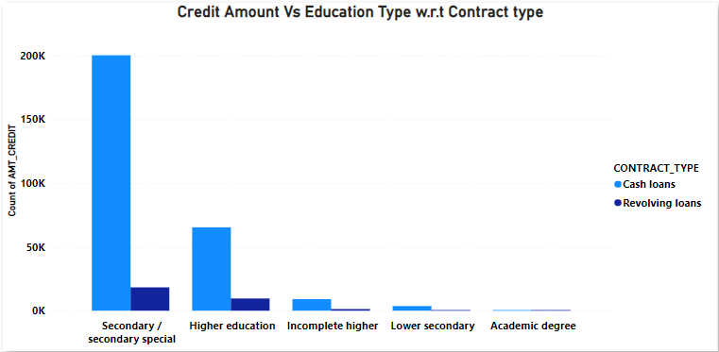
Bivariate Analysis
So to bivariate analysis I drag the Credit amount into value, contract type into legend and education type into x-axis.
1.Education status of higher education and secondary/secondary special have most clients for contract type cash loans
2.Most number of clients applying for revolving loans are in education status also are secondary/secondary special and higher education than other education type.

Slide 21
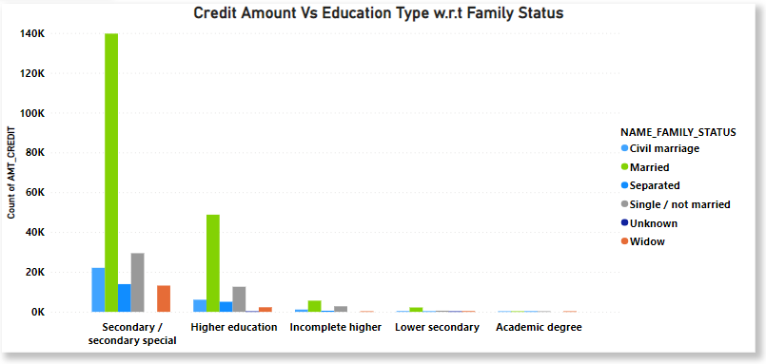
I drag the Credit amount into value, Education type into legend and family status into x-axis.
Family status of married of Secondary/secondary special education are having higher number of credits than others, then family status of civil marriage and separated of secondary/ secondary special education type having higher number of credits than others.

Slide 22
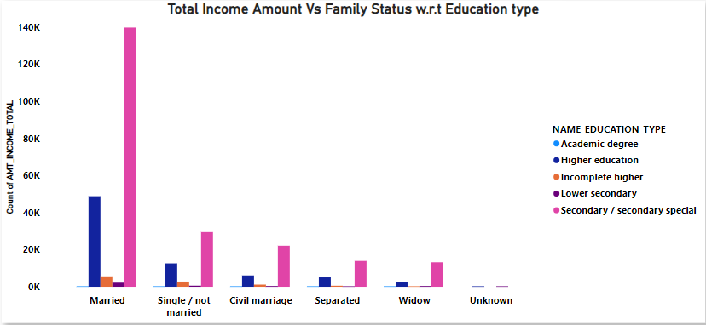
I drag the Credit amount into value, family status into legend and education type into x-axis.
1.Family status of 'civil marriage', 'marriage' and ‘Single/not married' of secondary/ secondary special are having higher number of income than others.
2.All family status of academic degree education type having minority of income rate. It means bank having less loan customers in education type academic degree. As we see earlier in contract type.

Slide 23
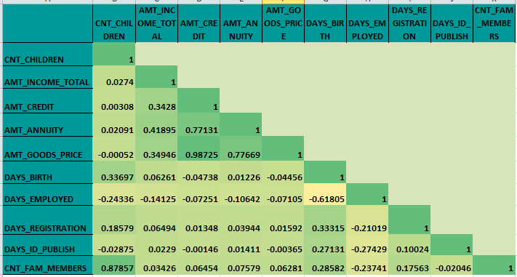
Correlations (target 0)
The below chart provides correlation of different variables for clients with no payment difficulties.
For Correlation I filter the target variable to 0 and selected the all variables then clicked the data bar then click on Data analysis.
As we can see top 10 correlations.
Family member & children count
Goods price& credit
Annuity & credit
Goods price& annuity
Annuity &total income
Credit &total income
Goods price& total income
Day birth & children count
Day registration & days birth
Days publish & days birth

Slide 24
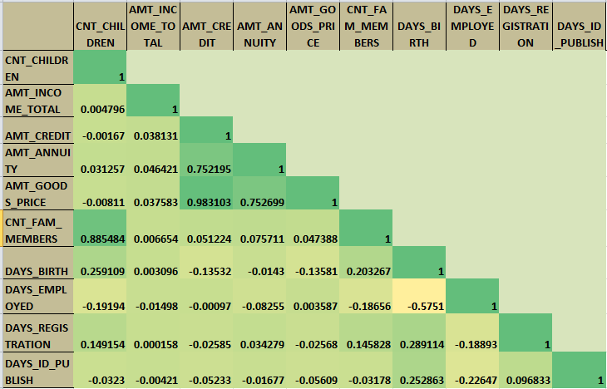
Correlation ( target 1)
Same as before I filter the target variable to 1 and selected the variables then clicked the data bar then click on Data analysis.
So these are the top 10 correlations
Family mem &children count
Goods price & credit
Annuity & credit
Goods price & annuity
Days birth & family member
Days registration & days birth
Days publish & days birth
Days registration & family member
Days registration & children count
Days id publish & days registration
The above chart provides correlation of different variables for clients with payment difficulties

Slide 25
Insights (previous_application.csv)
Data Cleaning: The dataset contained more than 1.6 million rows and 37
columns of data.
So I used Power BI software because there are more than million rows of data which cannot be import in Excel, after importing the dataset into power BI basically I transform the data by removing unwanted column contained 45% of blank data.
After deleting unwanted columns we got 34 remaining columns.

Slide 26
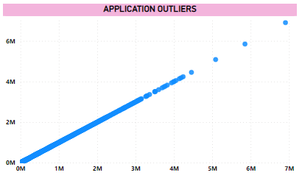
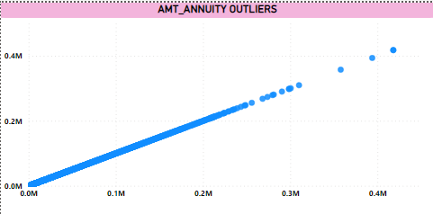
Outliers
Outliers can only be identified on Numerical variable.
To find outlier basically I used Scatter plot chart.

Slide 27
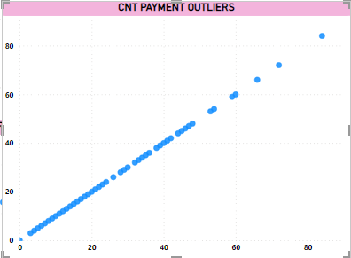
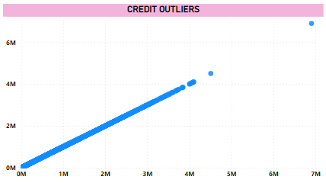

Slide 28
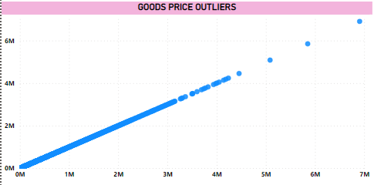

Slide 29
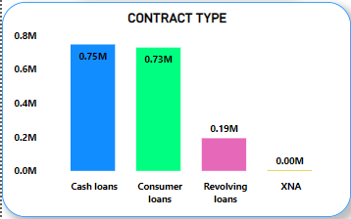
Data Imbalance:
Below are the columns where data is unevenly distributed

Slide 30
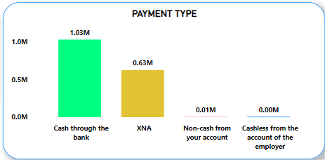
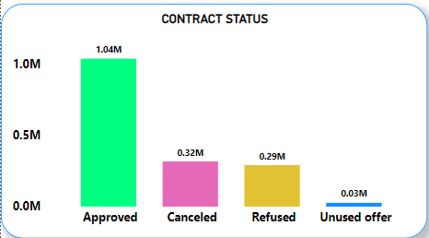

Slide 31
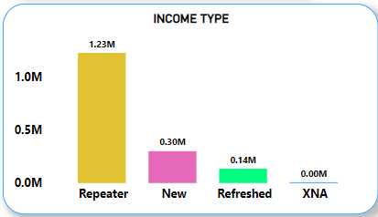
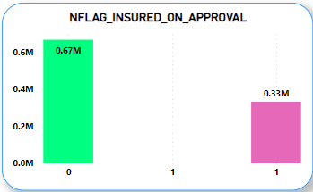

Slide 32
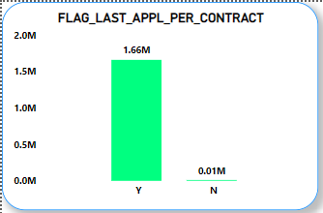
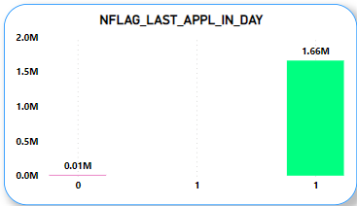

Slide 33
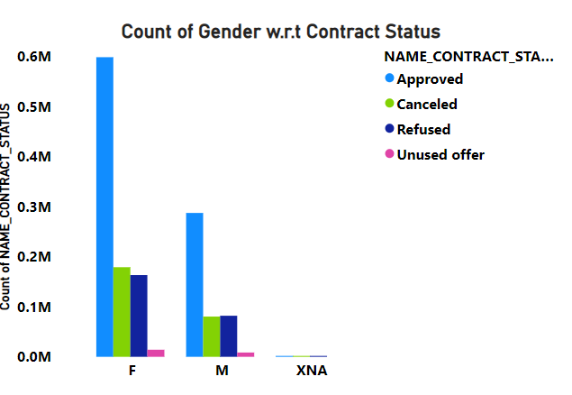
Univariate Analysis
So for univariate analysis I did same as application_data.csv dataset.
And after this I create relationship between both dataset table.
Maximum approved loans are for female clients
It can also be observed that male clients use most of the offers of loans as unused offers are very less for male clients than that of female clients.

Slide 34
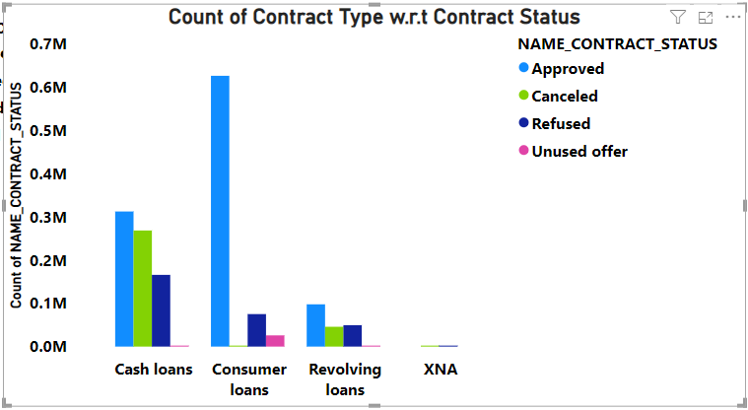
Contract type cash loans are maximum in number where all kinds of contract statuses are more than contract type revolving loans
Consumer loans are most approved loans.

Slide 35
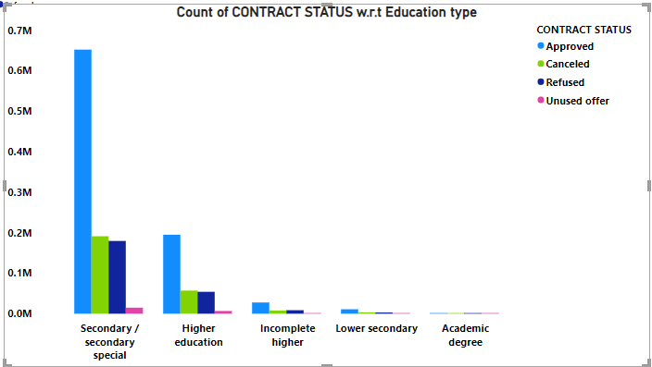
Most clients with all kinds of education types have approved rate is better than canceled, refused rate.

Slide 36
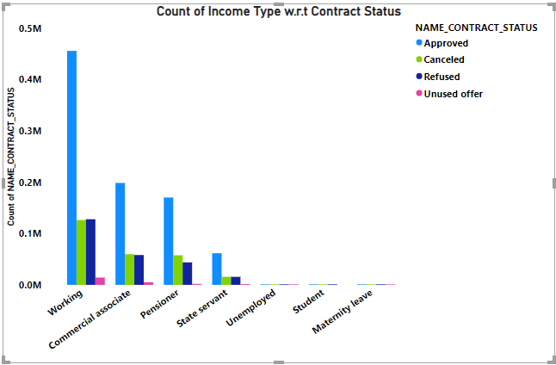
There are very less rate of getting approved and unused offer for students and for maternity leave income type.
The number of approved loans for state servants is almost equal to the refusal or canceled loans for Commercial associates.
Maximum unused offers is by working clients and more approved is by working clients.

Slide 37
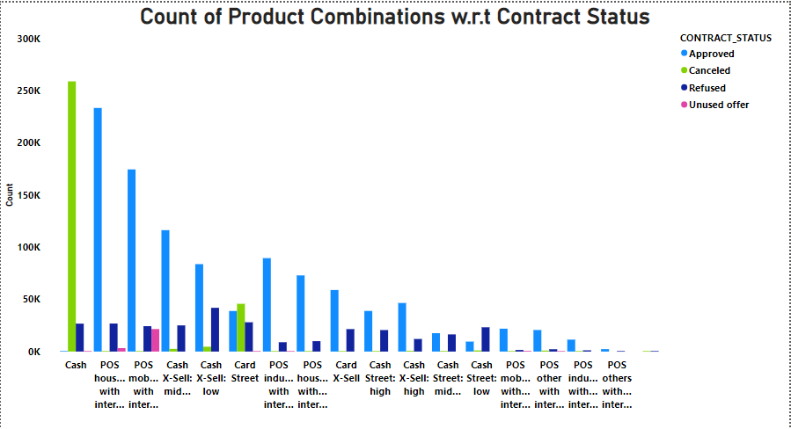
Most canceled loans are of the product combination, Cash.
Most refused loans are of product combination Cash X-Sell: low
Some product combinations are null incase of unused offers as well as cancelled loans
POS industry without interest
POS others without interest

Slide 38
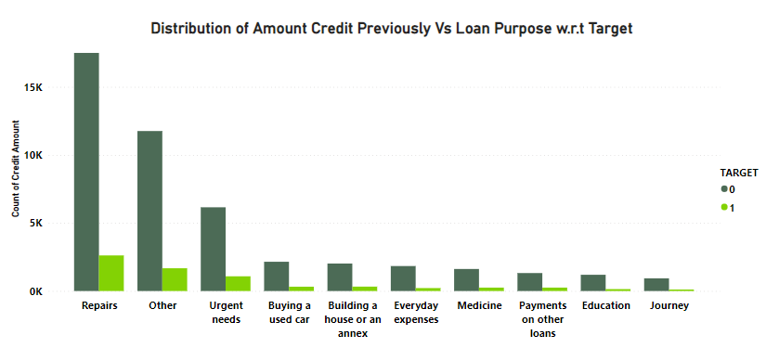
Bivariate Analysis for previous_application.csv
The credit amount of Loan purposes like ‘urgent needs’, ‘buying a used car’ and ‘building a house’ are higher and also they are having no payment difficulties.
Repairs loan purpose have maximum number of payment difficulties clients and maximum number of no payment difficulties clients.

Slide 39
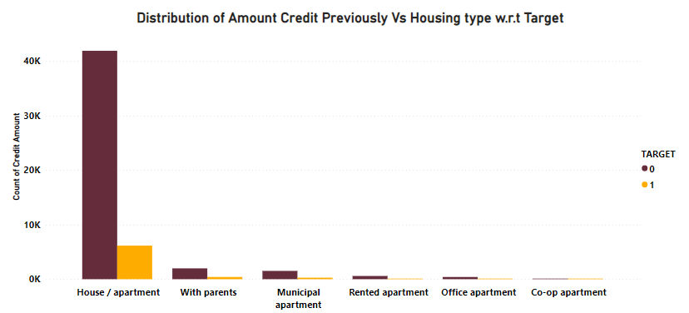
Here for Housing type, house/apartment is having higher credit of target 1.
So, we can conclude that bank should avoid giving loans to the housing type of office apartment , rented apartment and co-op apartment as they are having difficulties in payment.
Bank can focus mostly on housing type with parents or House or apartment or municipal apartment for successful payments.

Slide 40
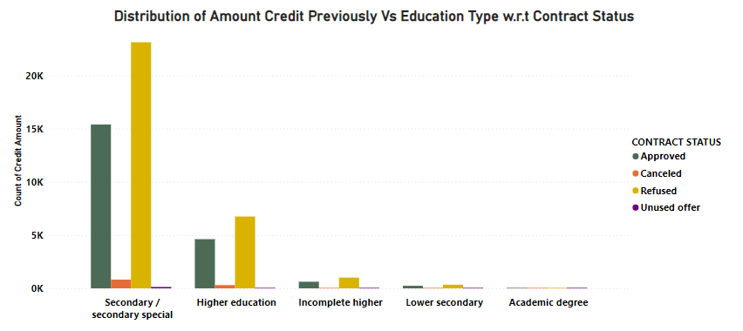
It can be seen that number of refusals are for clients has nothing to do with their education levels
Almost all education level clients have equal unused offers.

Slide 41
Results
Bank should focus on education type higher education and secondary/secondary special who took cash loan or revolving loan are capable of successful payment on time.
All type of organization don’t have any payment difficulties. Except business entity type 3 and self employed have some payment difficulties but it is negligible.
Contract type revolving loans have leas client with payment difficulties.
Bank should focus on income type working, commercial associate and pensioner they are capable of successful payment back to bank.
Housing type house/apartment, with parents and munsipal apartment have more clients with no payment difficulties than payment difficulties.

Slide 42
The end

